Slide 1
Workshop: Astroidinator code creation A
Dick van Kalsbeek 24mar2024

Slide 2
Intro – from specification to code
Goal of the workshop
Approach
Tasks coming week
Hands-on and tracking of actions

Slide 3
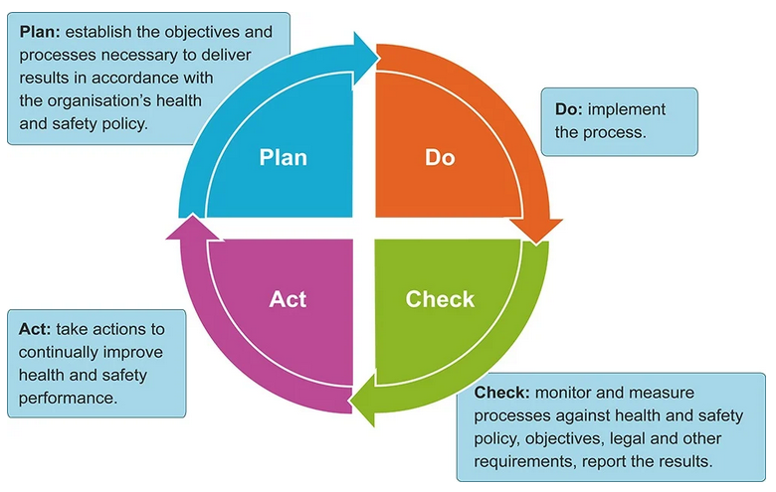
Goal of this workshop
Determine the specifications of the application Astroidinator
Create a list, Trello or any system to track your actions
Getting started with the basic functionality
Plan tasks for the coming weeks

Slide 4
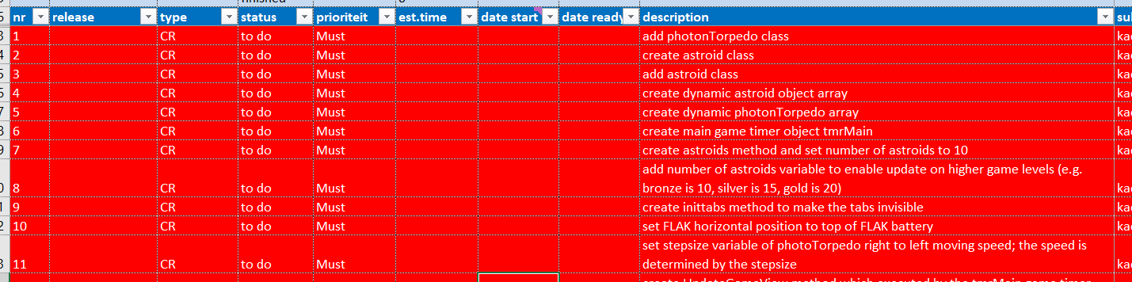
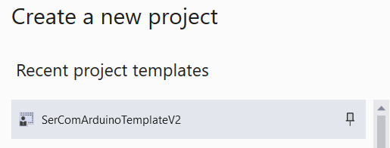
Approach
This is the way I work..
A list with every requirement I can think of, check the list and decide the priority
Create the Visual Studio application, start with the template
You already did this for testing purposes of the Arduino handling
Create methods and add summaries or comment what it should do

Slide 5
Tasks this and next week
All IPC actions set as ‘doing’
Example:
Actions
Estimate the time you need, just to monitor later on. You’ll learn how to estimate.
And YES, I am over-confident myself all the time too.
Set start date when starting, set end date when finished
Discuss and perhaps work together on the solution, and write down who is responsible
Add comment in column ‘solution/remarks’ if the solution needed discussion or thinking time

Slide 6
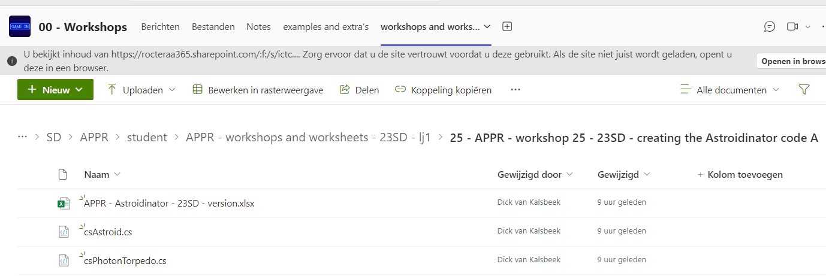
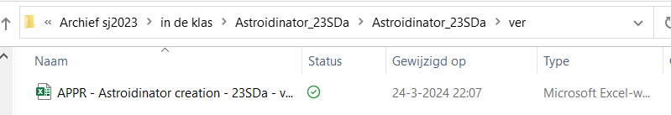
Hands-on and tracking of actions
In teams: workshop 25, download the list
Decide if you want to use this or Trello or something else..
If you use the list, save it in a directory ‘ver’ in the solution
Save Excel as.. Goto application directory.. Create the ‘’ver’ directory and OK!
Follow my actions. This is optional. You are allowed to work on your own if you feel confident.

Slide 7

The end..

Slide 8
xx

